Slide 1
Implementation Diagram
It shows the implementation phase of systems development, such as the source code structure and the run-time implementation structure.

Slide 2
Types of Implementation Diagrams
There are two types of implementation diagrams:
component diagrams show the structure of the code itself,
and
deployment diagrams show the structure of the runtime system

Slide 3
a) Component diagram
Component diagrams are used to model the physical aspects of a system.
It model the physical components(such as source code, executable program, user interface, libraries,dll’s) in a design.

Slide 4
Component diagram…..
Component diagrams can also be described as a static implementation view of a system.
Static implementation represents the organization of the components at a particular moment.
A single component diagram cannot represent the entire system but a collection of diagrams is used to represent the whole.

Slide 5
Purpose of Component Diagrams
Visualize the components of a system.
Construct executables by using forward and reverse engineering.
Describe the organization and relationships of the components.

Slide 6
Drawing a Component Diagram….
Component diagrams are used during the implementation phase of an application. However, it is prepared well in advance to visualize the implementation details.

Slide 7
Before drawing a component diagram, the following artifacts are to be identified clearly −
Files used in the system.
Libraries and other artifacts relevant to the application.
Relationships among the artifacts.

Slide 8
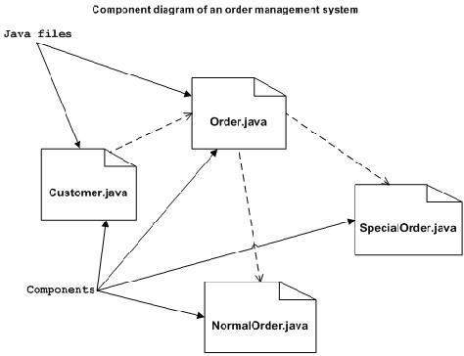

Slide 9
Component diagrams can be used to
Model the components of a system.
Model the database schema.
Model the executables of an application.
Model the system's source code.

Slide 10
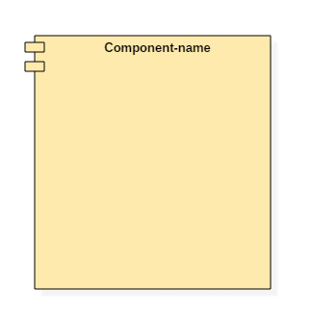
Component diagram Notations
A component
A component is a replaceable and executable piece of a system whose implementation details are hidden.

Slide 11
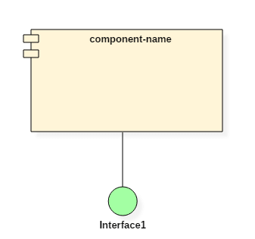
Component diagram Notations
A component
<< component >>. Component details are hidden for the outside world. The name of a component is placed at the center of a rectangle. A component icon is displayed at the upper right corner of a rectangle, which is optional.
The interface is a named set of public features. It separates the specification of functionality from its implementation by a class diagram or a subsystem.

Slide 12
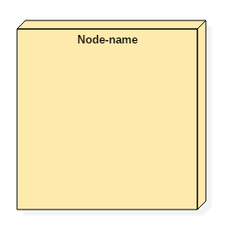
Component diagram Notations
A node

Slide 13
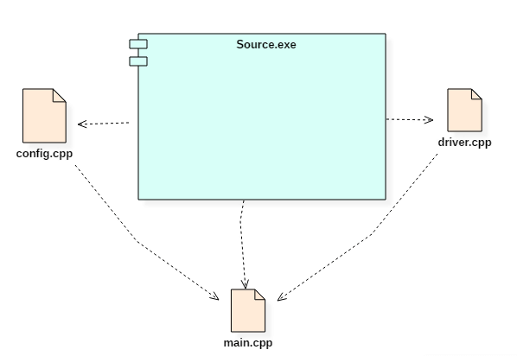
Component diagram - Ex

Slide 14
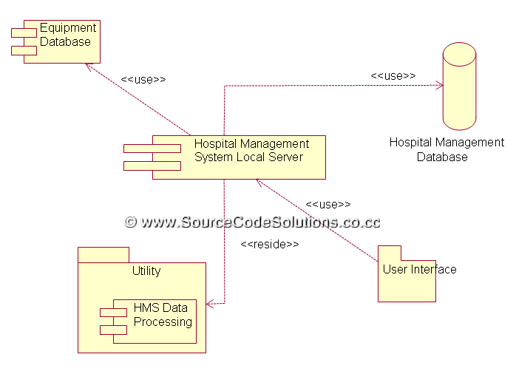
Component diagram

Slide 15
b) Deployment Diagram
Deployment diagram represents or describe the static deployment view of a system.
It specifies the physical hardware on which the software system will execute.
It also determines how the software is deployed on the underlying hardware.
It maps software pieces of a system to the device that are going to execute it.

Slide 16
Deployment Diagram
In most cases, component diagrams are used in conjunction with deployment diagrams to show how physical modules of code are distributed on various h/w platform.
In many cases, component and deployment can be combined.

Slide 17
Component Vs Deployment
Component diagrams are used to describe the components and deployment diagrams shows how they are deployed in hardware.

Slide 18
Deployment Diagram - What it shows ?
It show the configuration of run-time processing elements and the software components, processes, and objects that live in them.
Software component instances represent run-time manifestations of code units.

Slide 19
Before drawing a deployment diagram, the following artifacts should be identified −
Nodes
Relationships among nodes

Slide 20
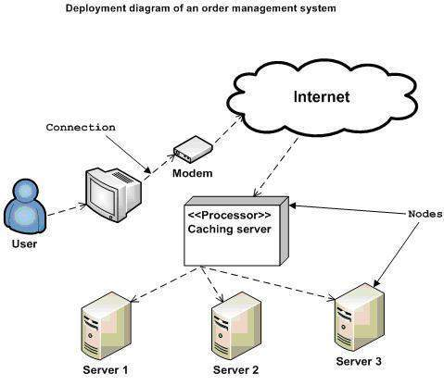
Deployment Diagram – Ex 1

Slide 21
Order Management System
Here, we have shown nodes as −
Monitor
Modem
Caching server
Server

Slide 22
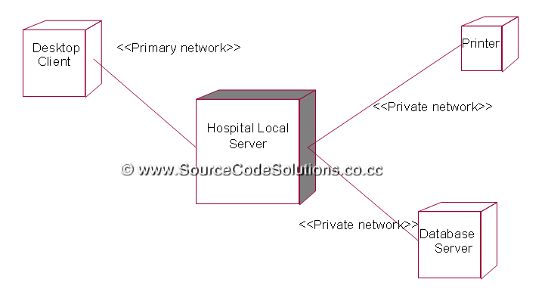
Deployment Diagram – Ex Hospital management

Slide 23
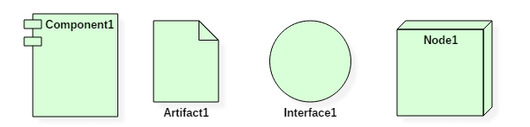
Deployment Diagram Symbol and notations

Slide 24
A deployment diagram consists of the following notations:
A node
A component
An artifact
An interface

Slide 25
Deployment diagrams can be used −
To model the hardware topology of a system.
To model the embedded system.
To model the hardware details for a client/server system.
To model the hardware details of a distributed application.
For Forward and Reverse engineering.

Slide 26
Package Diagram
A package is a grouping of model elements.
Packages themselves may contain other packages.
Package may contain both subordinate packages and ordinary model elements.
The entire system can be thought of as a single high-level package with everything else in it.
All UML model elements and diagrams can be organized into packages.
A package is represented as a folder, shown as a large rectangle with a tab attached to its upper left corner.
If contents of the package are shown, then the name of the package may be placed on the tab.
The contents of the package are shown within large rectangle.

